Slide 1
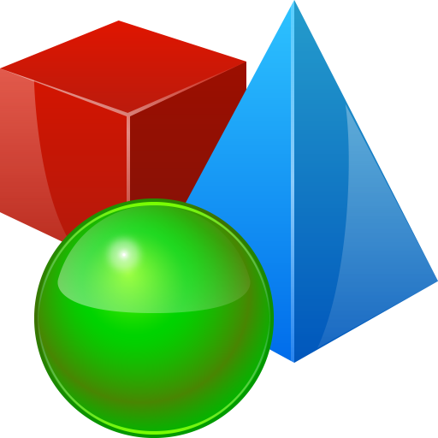
Objects and Classes
Using Objects and Classes Defining Simple Classes
SoftUni Team
Technical Trainers
Software University
https://softuni.bg

Slide 2
Have a Question?
sli.do
#prgm-for-qa

Slide 3
Table of Contents
Objects
Classes
Built-in Classes
Defining Simple Classes
Properties
Methods
Constructors

Slide 4

Objects and Classes
What is an Object? What is a Class?

Slide 5
Classes
Classes provide the structure for objects
Act as templates for objects of the same type
Classes define
Properties (data)
Behaviors (actions)
One class may have many instances
Sample class: Dog
Sample objects: sparky, rufus

Slide 6
Classes – Example
class Dog
{ public string Name { get; set; }
public string Breed { get; set; }
public int Age { get; set; }
public void Bark()
{ Console.WriteLine("Bark!"); } }
Name
Properties
Method

Slide 7
Objects
An object holds a set of named values
Creating a Dog object
Dog
Name = "Sparky" Breed = "Corgi" Age = 3
Object name
Object properties

Slide 8
Example: Objects
Create a new object of type Dog
Dog puppy = new Dog ("Sparky", "Corgi", 3);
The new operator creates a new object
Dog puppy = new Dog
{Name = "Sparky", Breed = "Corgi", Age = 3 };

Slide 9
Objects – Instances of Classes
Creating the object of a defined class is called instantiation
The instance is the object itself, which is created runtime
All instances have common behaviour
Dod sparky = new Dog("Sparky", "Corgi", 5);
Dog rufus = new Dog("Rufus", "Shepherd", 3);
Dog allie = new Dog("Allie", "Husky", 2);

Slide 10
Classes vs Objects
Classes provide structure for creating objects
An object is a single instance of a class
class Dog
object sparky
Object name
Name
Name: string
Breed: string
Age: int
Name = "Sparky"
Breed = "Corgi"
Age = 3
Properties
Object data
Bark(…)
Eat(…)
Methods

Slide 11
Using the Built-in API Classes
Math.Max()

Slide 12
Built-in API Classes in .NET Core
.NET Core provides thousands of ready-to-use classes
Packaged into namespaces like System, System.Text, System.Collections, System.Linq, System.Net, etc.
Using static .NET class members
Using non-static .NET classes
double cosine = Math.Cos(Math.PI);
Random rnd = new Random();
int randomNumber = rnd.Next(1, 99);

Slide 13

Creating Custom Classes
Defining Classes

Slide 14
Defining Simple Classes
Specification of a given type of objects from the real-world
Classes provide structure for describing and creating objects
Class name
Keyword
class Dice
{
…
}
Class body

Slide 15


Naming Classes
Use PascalCase naming
Use descriptive nouns
Avoid abbreviations
class Dice { … }
class BankAccount { … }
class IntegerCalculator { … }
class TPMF { … }
class bankaccount { … }
class intcalc { … }

Slide 16
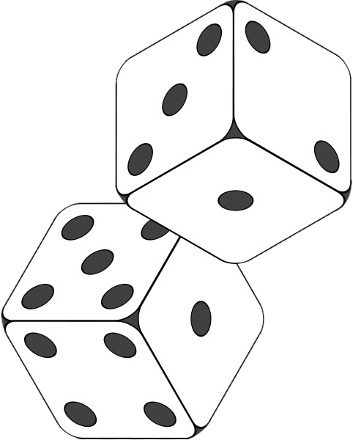
Class Members
Class is made up of state and behaviour
Properties store state
Methods describe behaviour
class Dice
{
public int Sides { get; set; }
public string Type { get; set; }
public void Roll() { }
}
Properties
Method

Slide 17

Creating an Object
A class can have many instances (objects)
class Program
{
public static void Main()
{
Dice diceD6 = new Dice();
Dice diceD8 = new Dice();
}
}
Use the new keyword

Slide 18
Properties
Describe the characteristics of a given class
class Student
{
public string FirstName { get; set;
public string LastName { get; set; }
public int Age { get; set; }
}
The getter provides access to the field
The setter provides field change

Slide 19
Methods
Store executable code (algorithm)
class Dice
{
public int Sides { get; set; }
public int Roll()
{
Random rnd = new Random();
return rnd.Next(1, Sides + 1);
}
}

Slide 20

Constructors
Special methods, executed during object creation
class Dice
{
public int Sides { get; set; }
public Dice()
{
this.Sides = 6;
}
}
Constructor name is the same as the name of the class
Overloading default constructor

Slide 21
Constructors
You can have multiple constructors in the same class
class Dice
{
public int Sides { get; set; }
public Dice() { }
public Dice(int sides)
{
this.Sides = sides;
}
}
Dice dice1 = new Dice();
Dice dice2 = new Dice(7);

Slide 22
Class Operations
Classes can define data (state) and operations (actions)
class Rectangle
{
public int Top { get; set; }
public int Left { get; set; }
public int Width { get; set; }
public int Height { get; set; }
int CalcArea()
{
return width * height;
}
Classes may hold data (properties)
Classes may hold operations (methods)

Slide 23

Summary
…
…
…
Objects
Holds a set of named values
Instance of a class
Classes define templates for object
Methods
Constructors
Properties

Slide 24









Questions?

Slide 25













SoftUni Diamond Partners

Slide 26
Trainings @ Software University (SoftUni)
Software University – High-Quality Education, Profession and Job for Software Developers
softuni.bg, about.softuni.bg
Software University Foundation
softuni.foundation
Software University @ Facebook
facebook.com/SoftwareUniversity
Software University Forums
forum.softuni.bg
Notes:
26

Slide 27

License
This course (slides, examples, demos, exercises, homework, documents, videos and other assets) is copyrighted content
Unauthorized copy, reproduction or use is illegal
© SoftUni – https://about.softuni.bg/
© Software University – https://softuni.bg
Notes:
27

